Slide 1
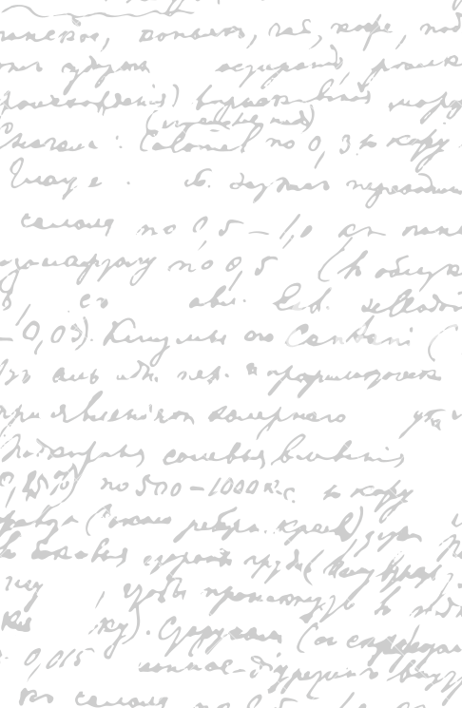



Ming Wu (Andrew) 2133861w
Laser Mate!
Project Supervisor Meeting 17
18 March 2021

Slide 2
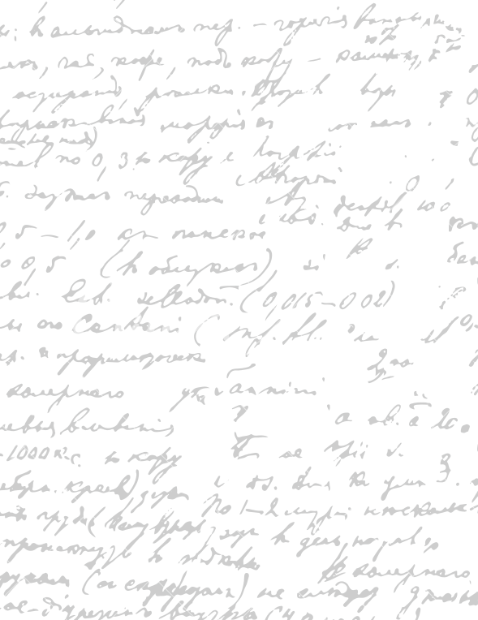



Start Recording

Slide 3

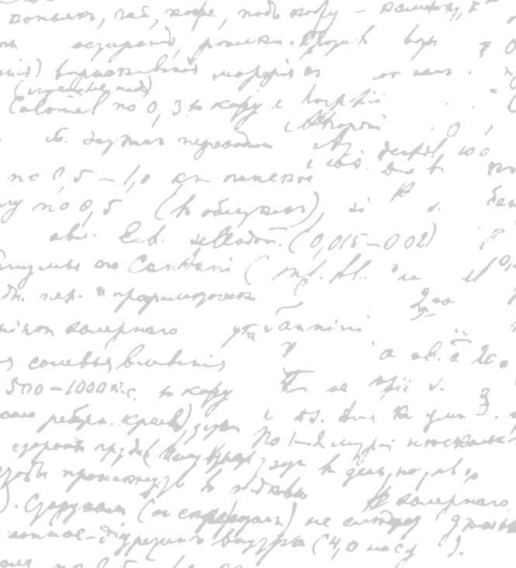

By next week, I will note down the main discussion points for each section (demonstrate with dissertation)
Project Plan

Slide 4
- Final Software Product
Database organization
Paper prototype
Design principles
Proofreading dissertation

Slide 5
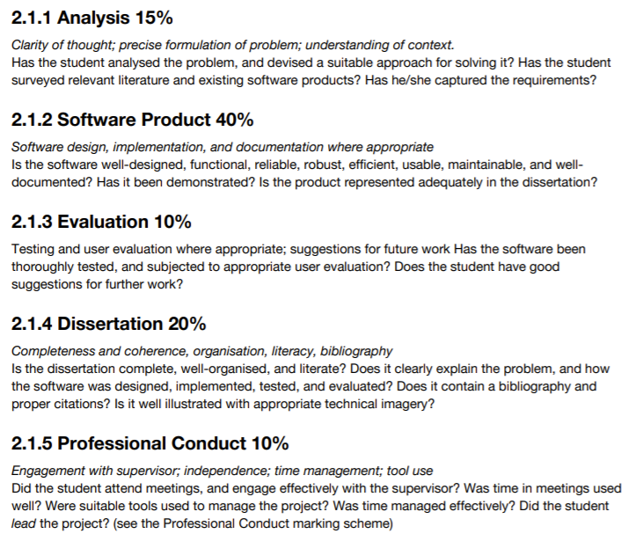

Slide 6
Software Coding
Testing Documentation
“programming + dissertation a week
Next Step

Slide 7
End

